Slide 1
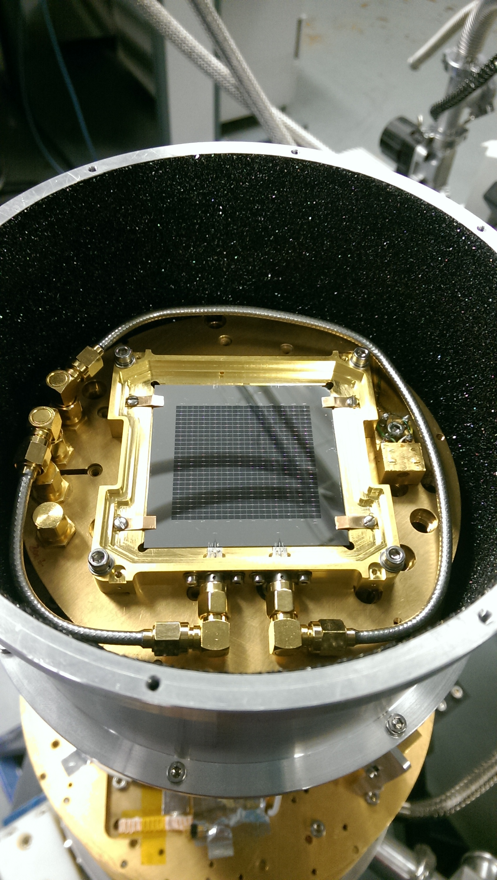

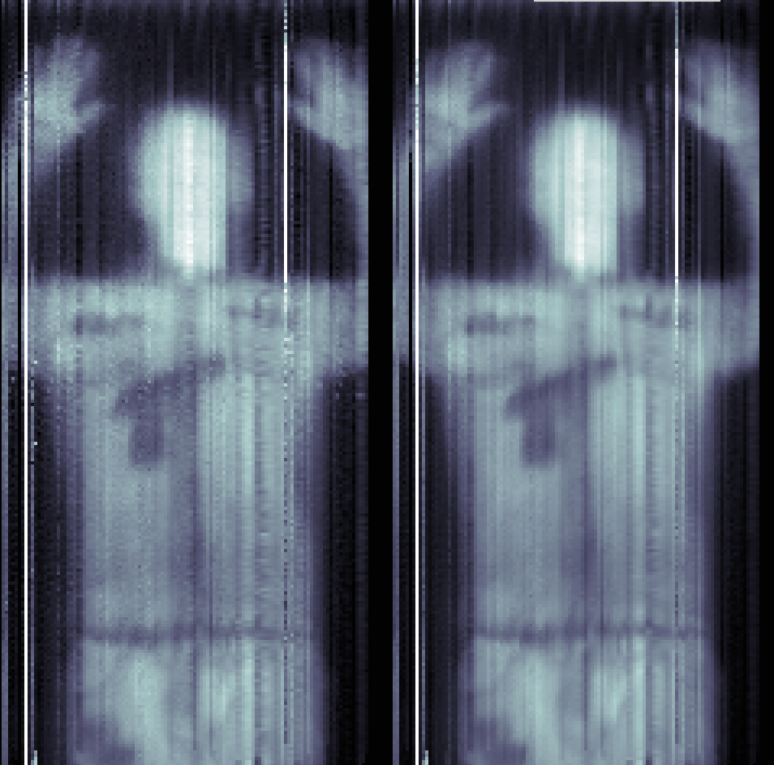
An Overview of Kinetic Inductance Detectors and Applications
Simon Doyle – Cardiff University

Slide 2
Talk Overview
Motivation for technology development
Basic introduction to superconductor below the transition temperature
The concept of Kinetic Inductance
Basics description of superconductors at RF frequencies.
Basic operating principal of a Kinetic Inductance Detector
Resonator types and differences
Multiplexed readout electronics
Current and future KID based instruments

Slide 3
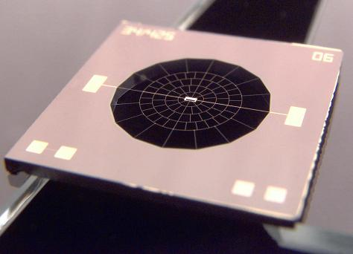
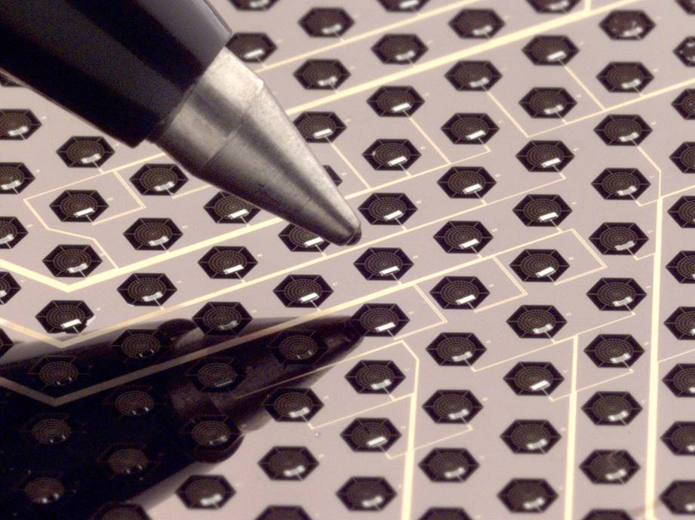
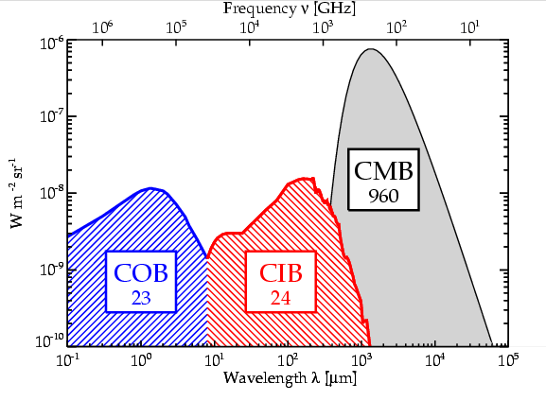
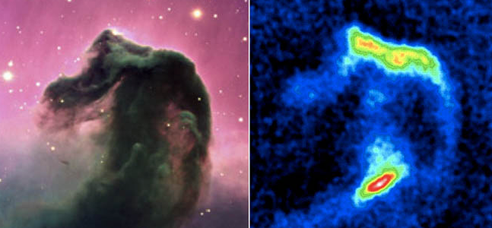
Motivation for detector development - Astronomy
Semi-conductor technology Limited to wavelengths of order 200um (1.5 THz)
Heterodyne receivers are typically noisy and not practical for large format imaging arrays
Bolometers have sensitivity but poor multiplexing ratios
Semi- conductor technology

Slide 4
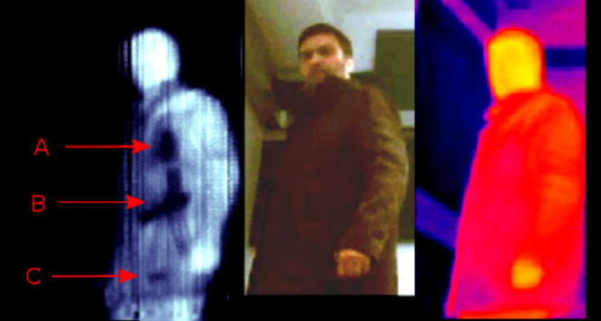
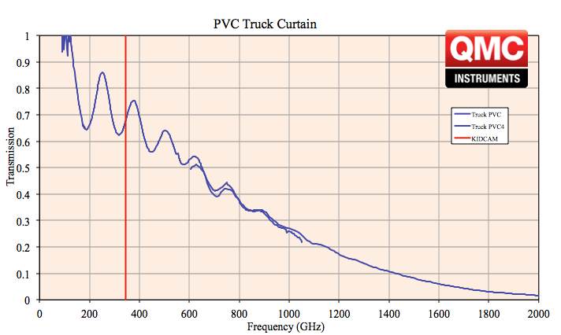

Motivation for detector development – Security and Industry

Slide 5
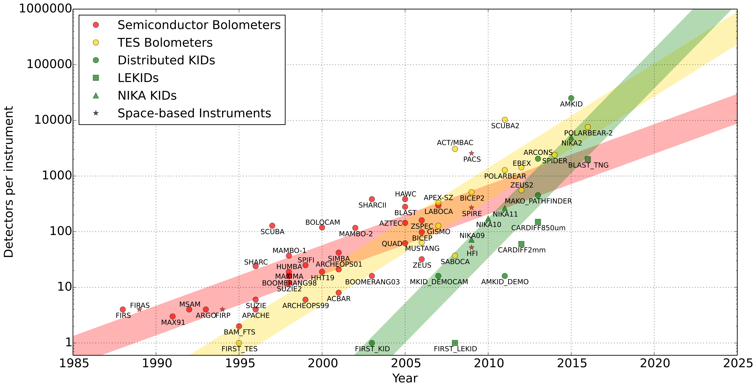
Motivation for detector development - Astronomy
Pixel counts in Astronomical receivers over the years

Slide 6
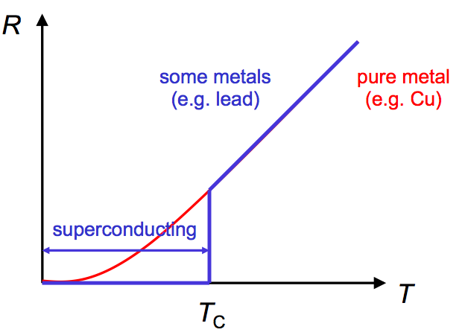
Basic Principals of a Superconductor
Superconductors are most famous for demonstrating zero DC resistance at temperatures below the transition temperature (T_{C})
It would seem that the Physical properties of the superconductor is not changing below T_{c}. However ……..

Slide 7
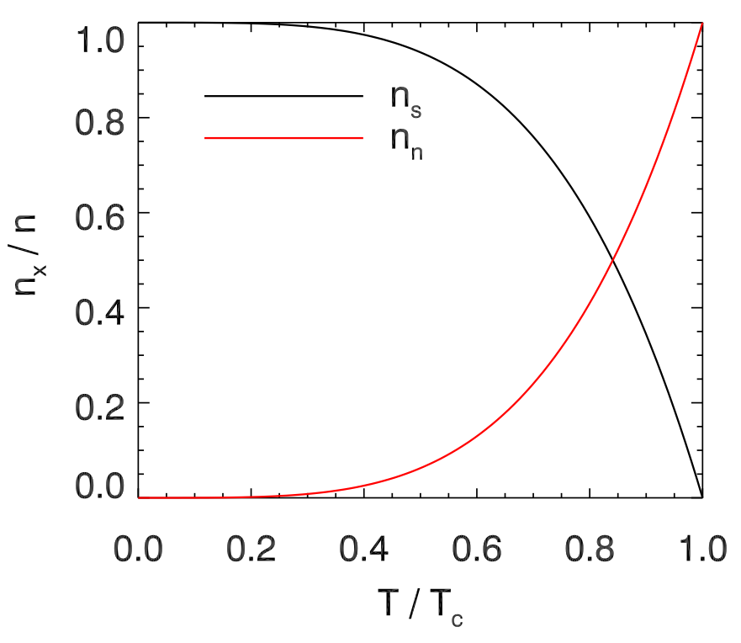
Below The Transition Temperature
Below T_{c} the electron population is dividing into separate populations.
A population of electrons weakly bound together called Copper pairs, bound together with an energy 2Δ (typically 0.4 meV) and denoted as n_{s}.
The remaining normal state electrons denoted n_{n} or n_{qp}
The populations can be described to first order by -
n_{n} Behave as normal state electrons.
n_{s} Are paired electrons bound by and Energy 2Δ. These paired electrons are immune from scattering and hence loss

Slide 8
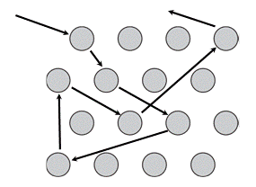
The conductivity of normal metals (Drude model)
m = 9.1x10⁻³¹
n_{n} ≈ 10²⁹
τ is typically of order 10⁻¹⁴ s and at practical frequencies, say f=5GHz (ω=3x10¹⁰) leaving ω²τ² << 1 and the imaginary term negligible.

Slide 9
Conductivity of non-scattering electrons
The phenomena of superconductivity arises from the non-scattering properties of the superconducting electron population n_{s}.
Consider the Drude model where τ ➔ ∞ to denote a non-scattering electron population n_{s}.

Slide 10
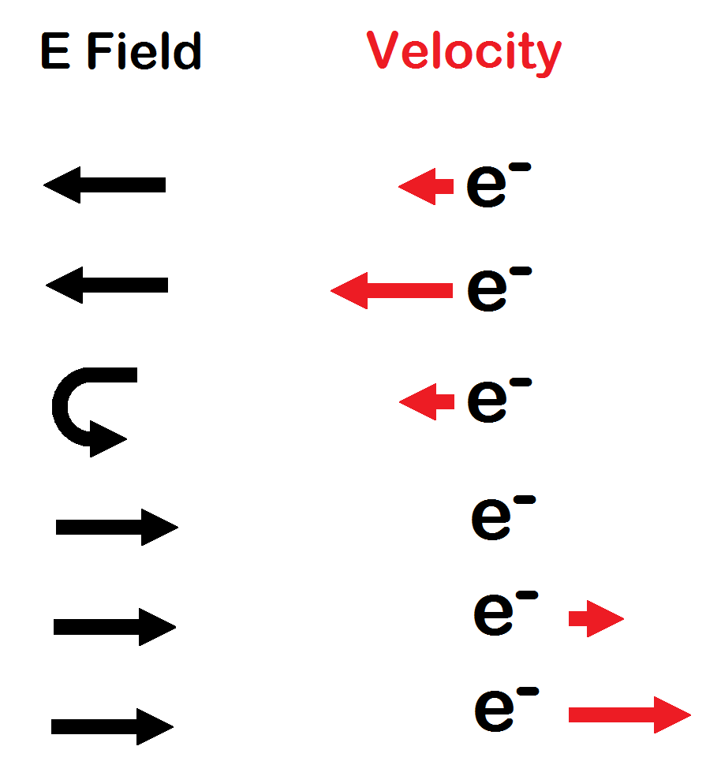
What is Kinetic Inductance?
A complex surface impedance associated with the inertia of a non-scattering electron population in a superconductor (Cooper-pairs).
As an electron is accelerated in an electric field it gains kinetic energy due to the velocity gained and the electron mass.
When the field is reversed the kinetic energy gained must be returned to the field before the electron can change direction. The electron velocity is proportional to the current, hence the current will lag the field as it would in an inductor.

Slide 11
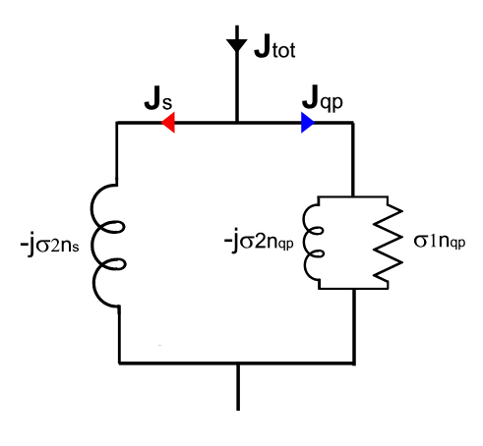
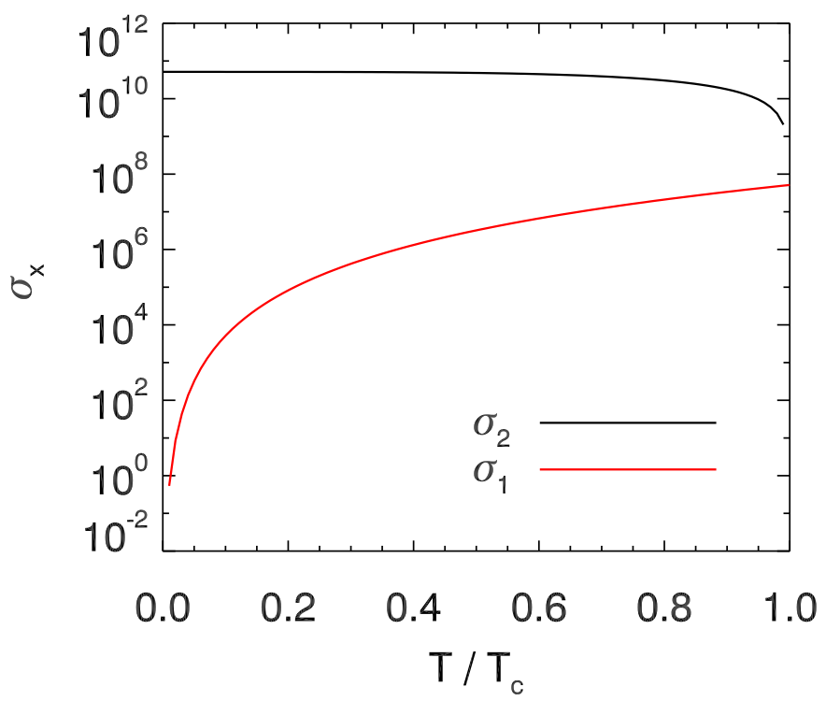
The two fluid model of superconductors
The resistive behavior of a superconductor at RF frequencies can be explained by considering the two fluid model.

Slide 12
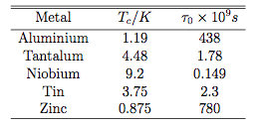
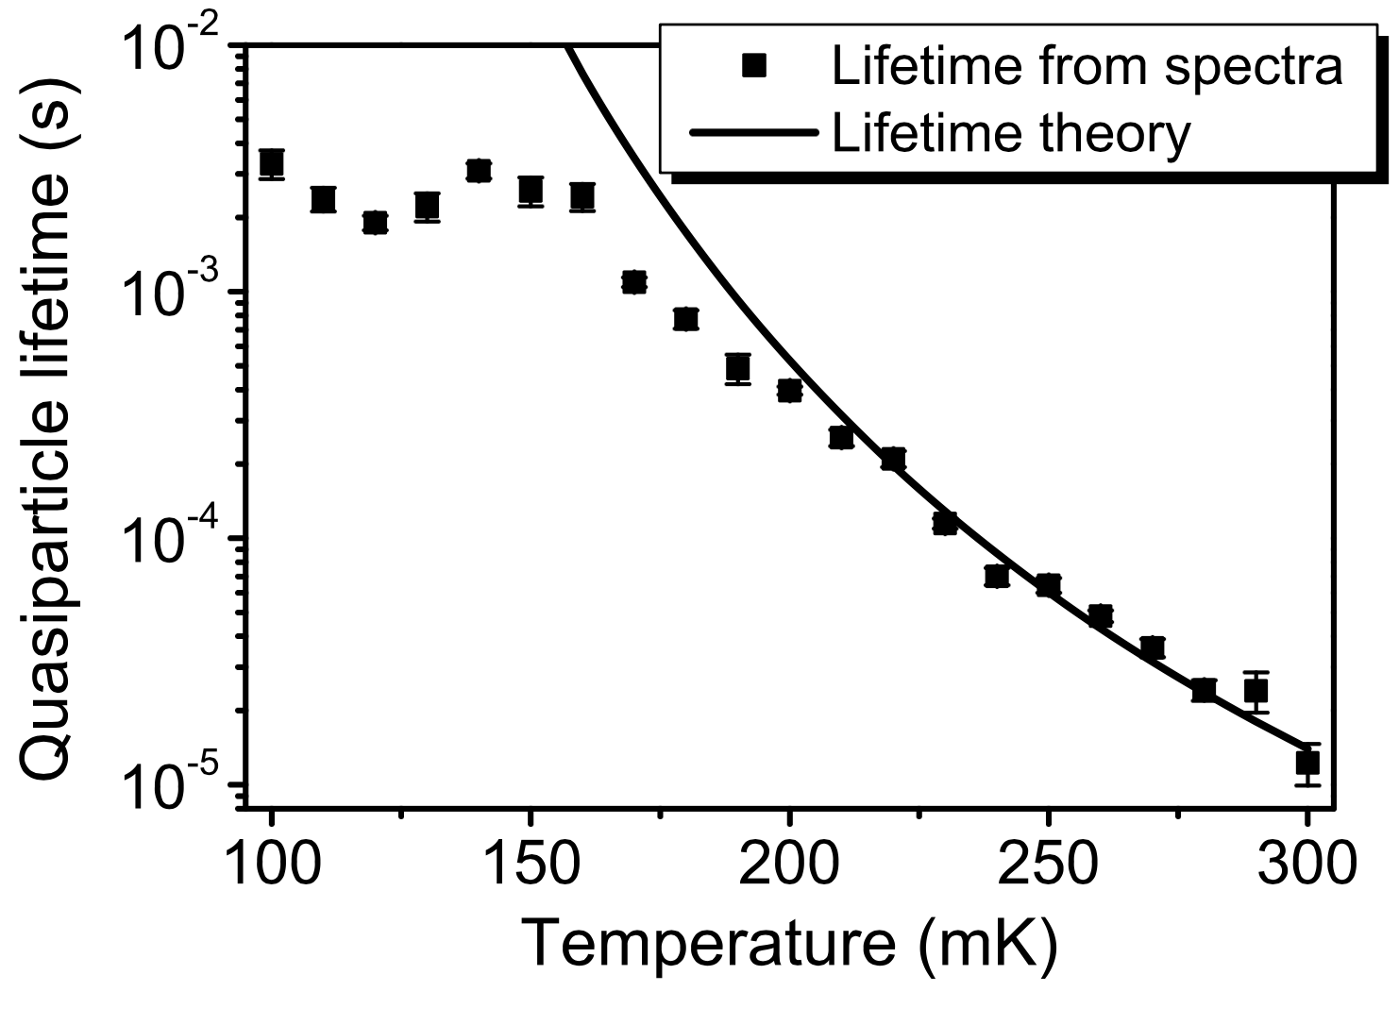
Quasi-particle lifetime
A Cooper pair can be split, by say absorbing a photon of energy hf>2Δ. The time for the quasi-particle to recombine to form a Cooper pair is dictated by the quasi-particle lifetime given by Kaplan theory:
Here τ₀ is a material dependent property
P.J. de Visser, et al., J. Low Temp. Phys., vol. 167, no. 3–4, pp. 335–340, Jan. 2012.

Slide 13
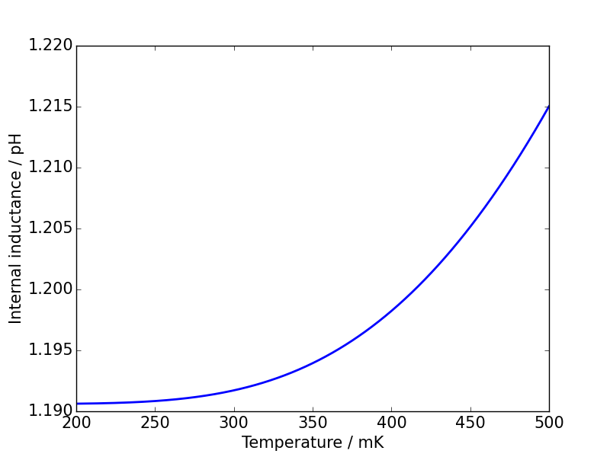
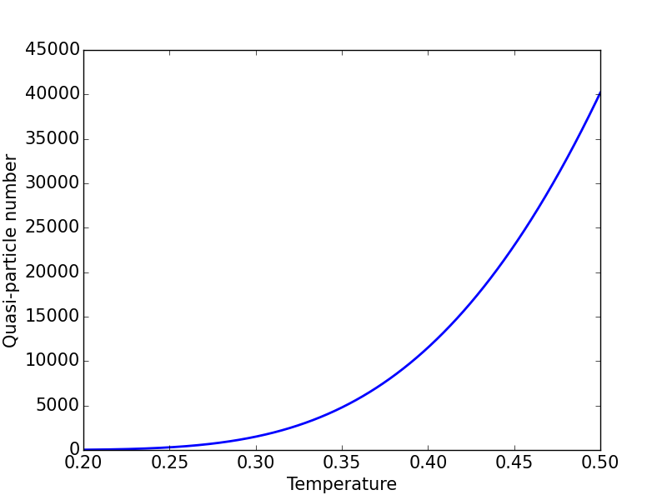
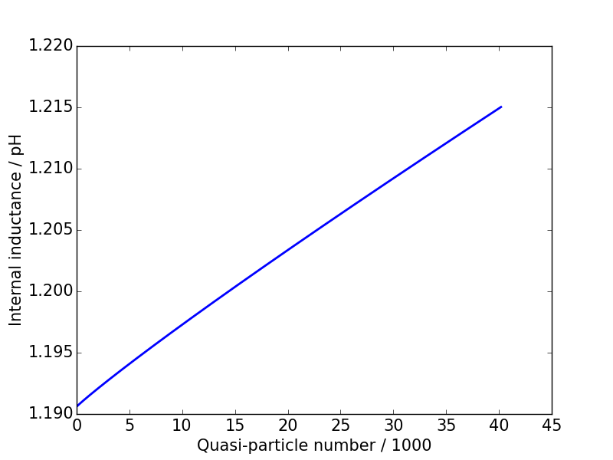
Response to change in quasi-particle density
30nm Al film 4x4μm patch simulated over 200-500mK
Change in L_{int} with temperature is small at T << TC
Change in L_{int} with quasi-particle number typically of order 10⁻¹⁸ H/QP

Slide 14
To recap
Superconductor have two electron population
  A normal state population giving a conductivity σ₁
  A paired population that does not scatter giving a conductivity σ₂
  Photon absorption alters the populations increasing σ₁ and reducing σ_{2.}
  The number of quasi-particles generated for a given power is proportional to the quasi-particle lifetime.
  This is the basis of photon detection

Slide 15
How to measure small changes in surface impedance
Change in internal inductance is still relatively small for typical variations in source power
This small change can be sensed using:
  Hi Q microwave resonators
  Low noise cryogenic amplifiers

Slide 16
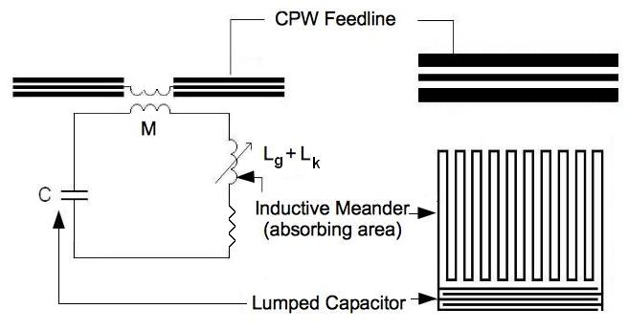
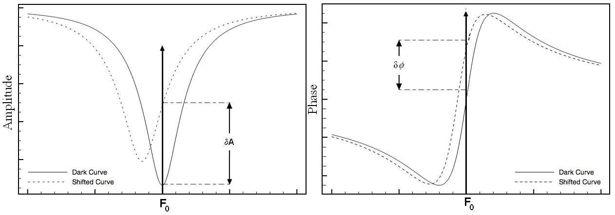
Basic principals of a Kinetic Inductance Detector

Slide 17
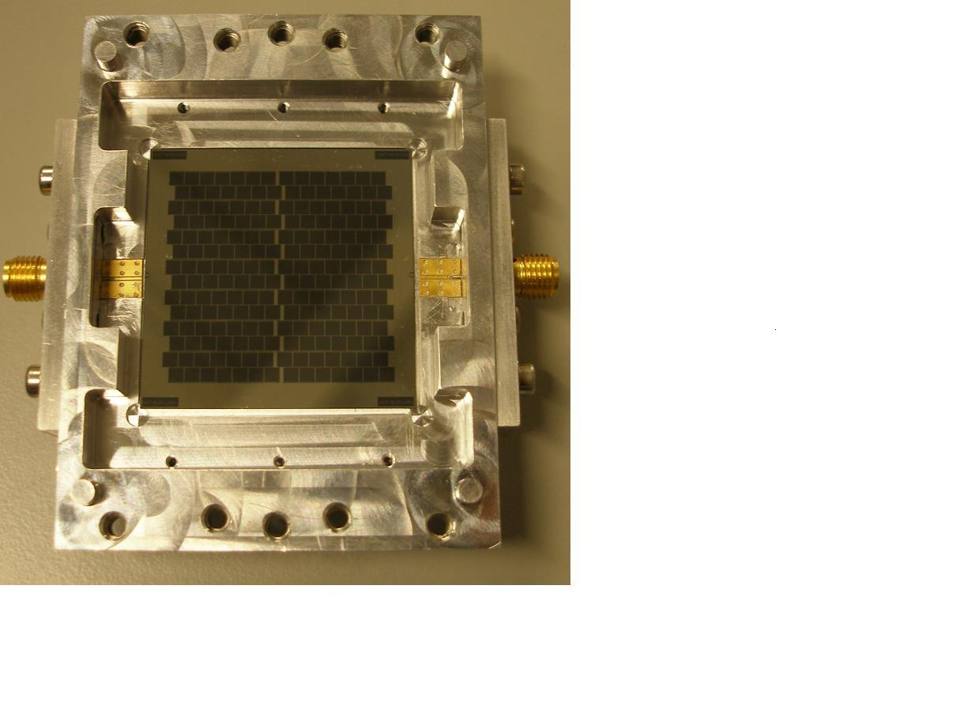
Types of KID detector – The Lumped Element Kinetic Inductance Detector (LEKID)

Slide 18
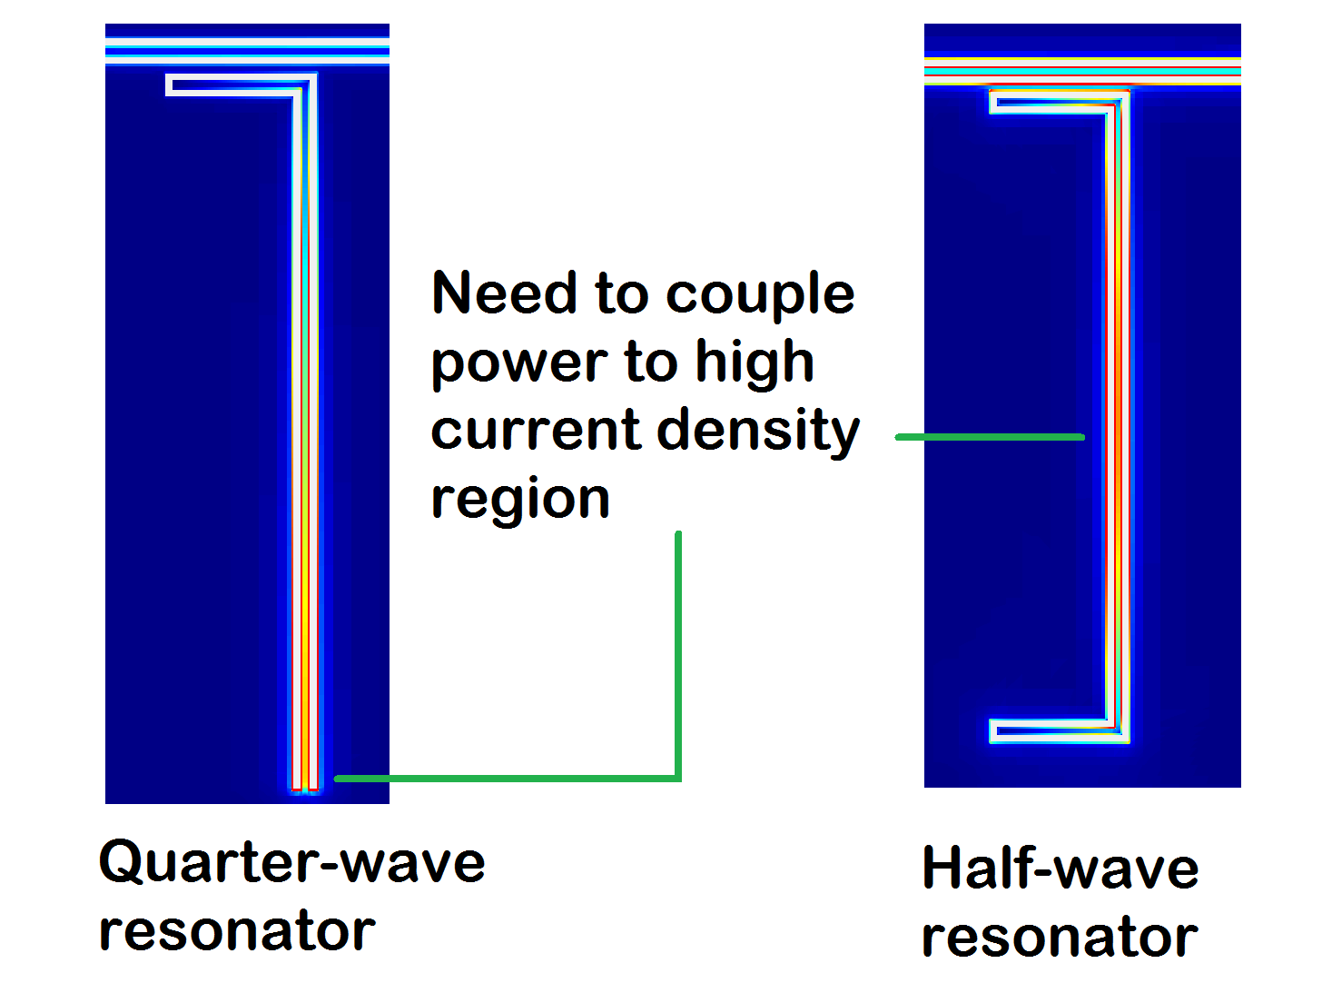
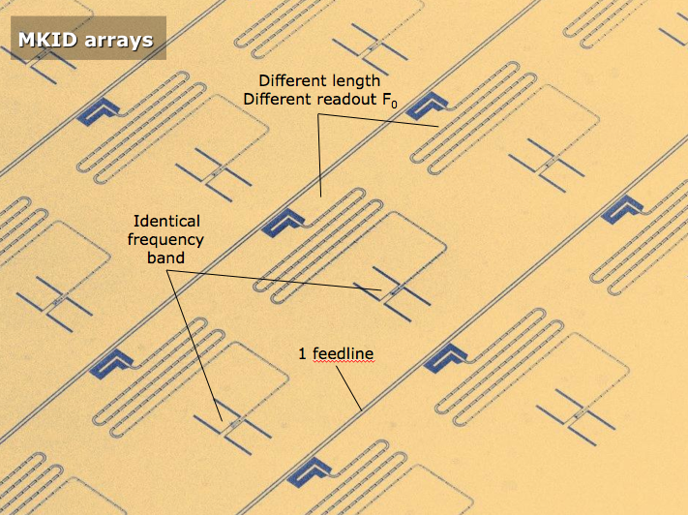
Types of KID detector – Distributed Kinetic Inductance Detector (MKID)

Slide 19
Measuring the sensitivity
The sensitivity of any detector is measured by:
  Measuring the response to optical power – in the case of the KID dF₀/dP.
The sensitivity then depends on how accurately you can measure this response. We define a time over which we average measurement of the response to be 0.5s.
  For a KID we measure F₀ for 0.5s and establish an error in our measurement. This is the noise

Slide 20
Measuring the sensitivity
Noise occurs over a range of frequencies and forms a noise spectrum.
In practice me measure this noise spectrum.
This is done by measuring F₀ for a period of time and taking a Fourier transform.
The resulting Fourier transform is scaled to give the noise in a 1 Hz bandwidth (0.5s) of integration as a function of frequency.

Slide 21
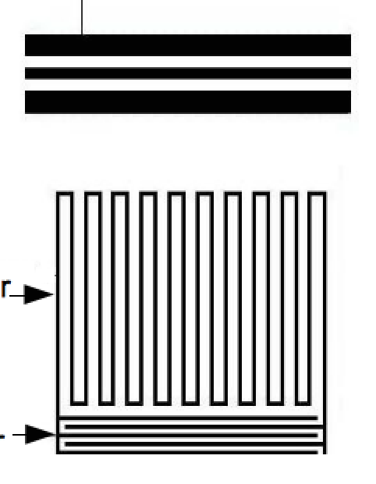
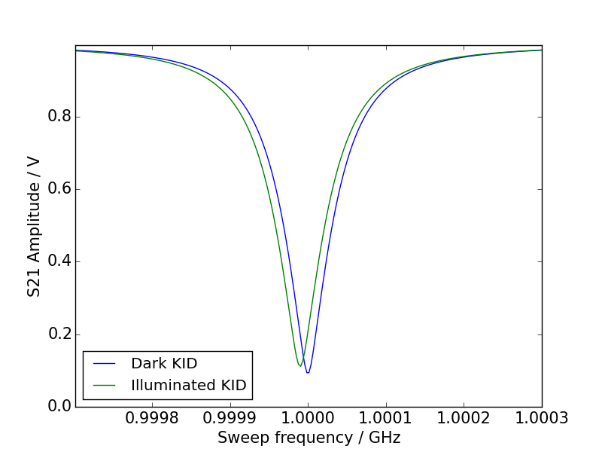
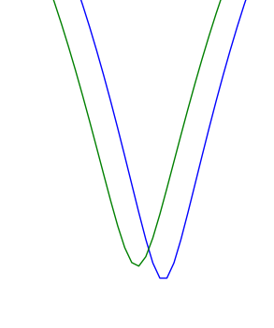
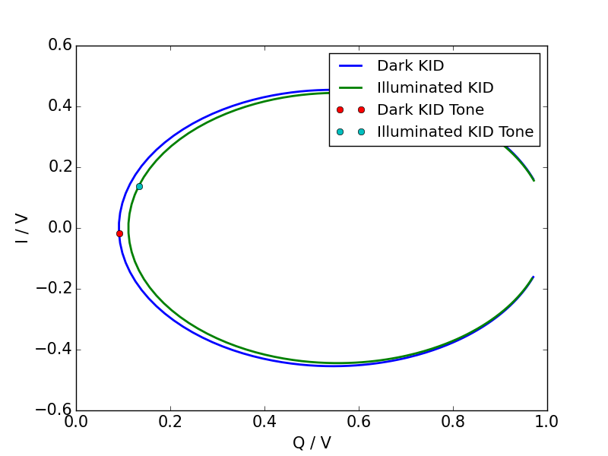
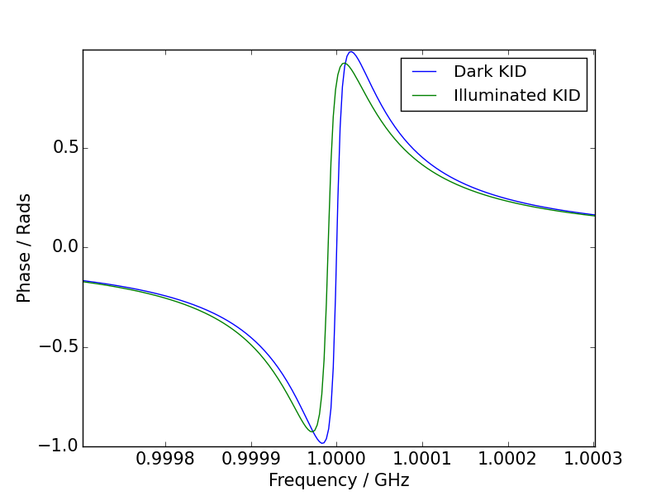
KID readout in the complex plane (IQ)
Tone in
Tone out

Slide 22
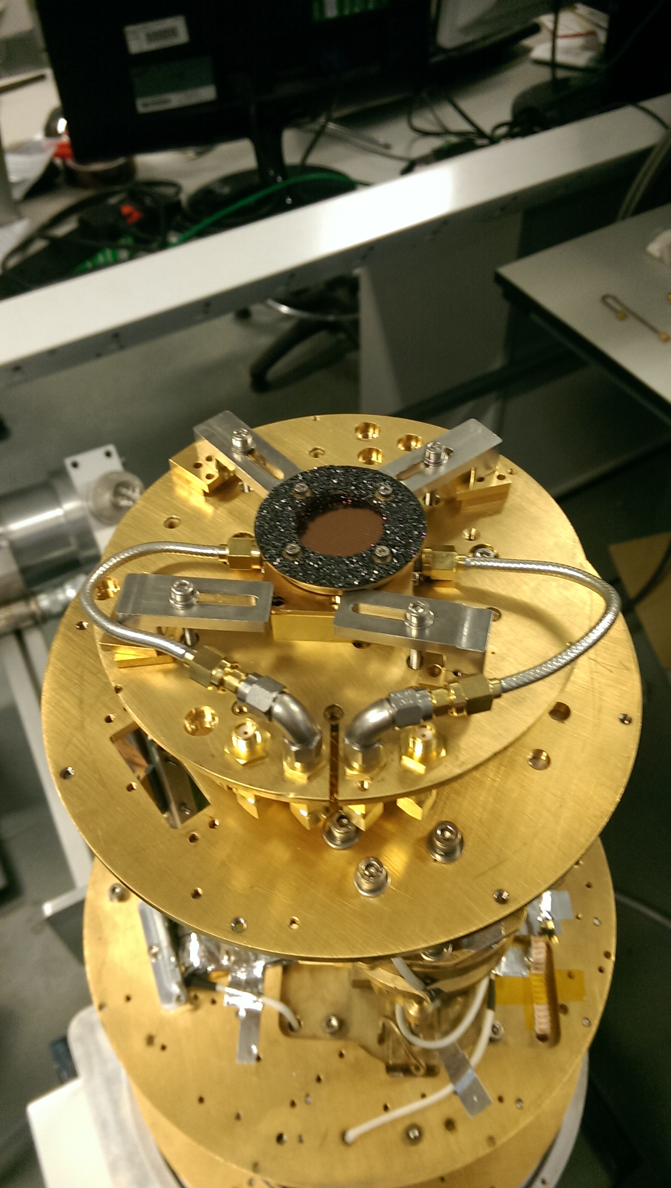
Measuring sensitivity
Detector

Slide 23
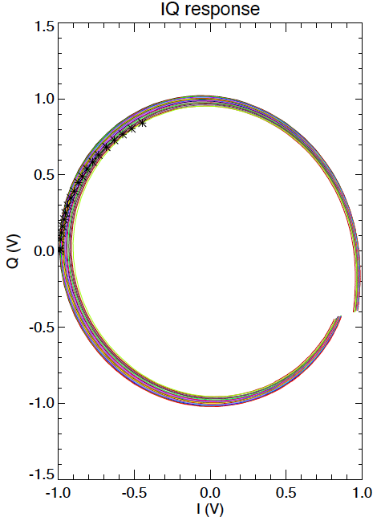
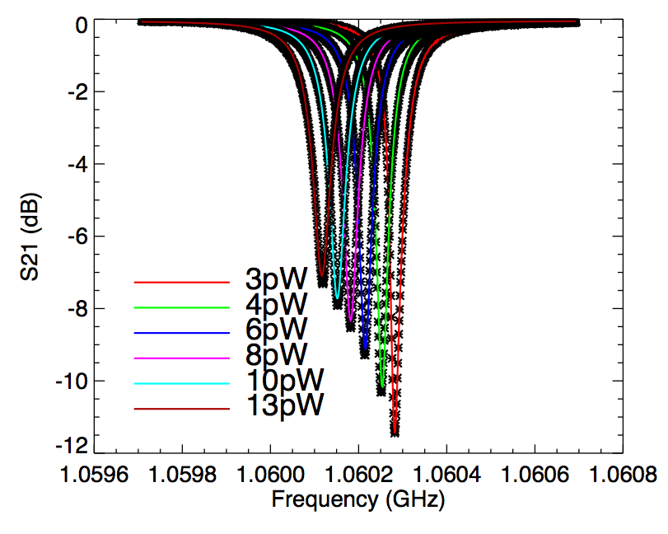
Response to photon absorption

Slide 24
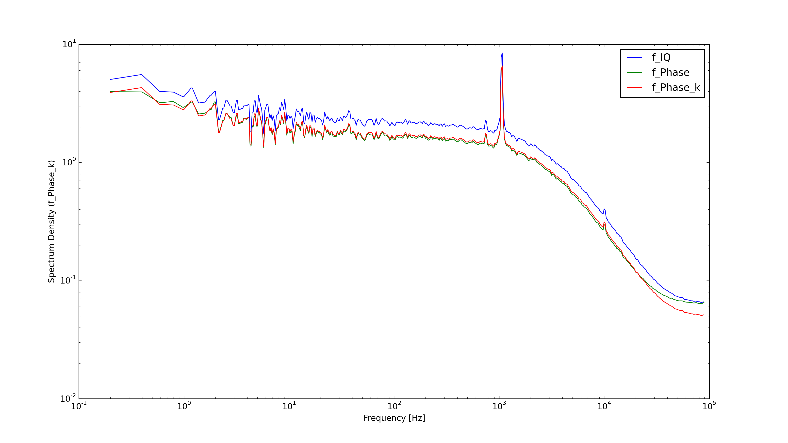
Typical noise spectra of a KID
Generally clean noise spectra due to low susceptibility to EM noise sources.
Frequency noise [Hz²/Hz]
10¹
10⁰
10⁻¹
10⁻²
10⁰
10¹
10²
10³
10⁴
10⁵
Frequency [Hz]
Inherent detector noise
GR or Photon
Roll off due to Quasi-particle lifetime
Amplifier noise floor

Slide 25
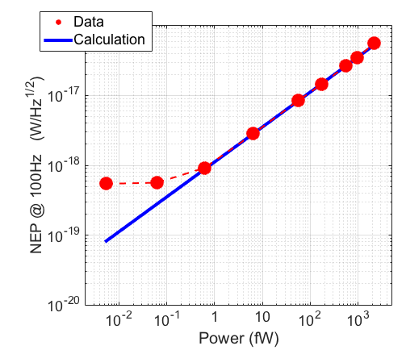
So we have a sensitive detector!
KID detectors are extremely sensitive.
Reach the photon noise limit down to powers of 1fW (10⁻¹⁵W)
This is the limit of any measurement imposed by the natural noise associated with the random arrival rate of photons from a source.
KID at 100mK better performance from cooling further
KID at 220mK

Slide 26
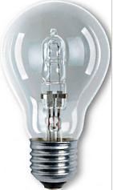
Putting NEP into context
A 100W incandescent light bulb produces about 5W of optical power.
If we placed our detector on a modest telescope with 1m² collecting area, how far away can our light bulb be an still be detected in 0.5 second of observing?
NEP=5x10⁻¹⁸ W/s^{0.5} which means we have a signal to noise ratio of 1 if we observe for 0.5s. If we observe for 1 second this increases by √2 ≈ 1.4 - so just observable.
Flux at distance D from bulb
We collect over the 1m² area of the telescope so:
About 70% of the distance to the moon!

Slide 27
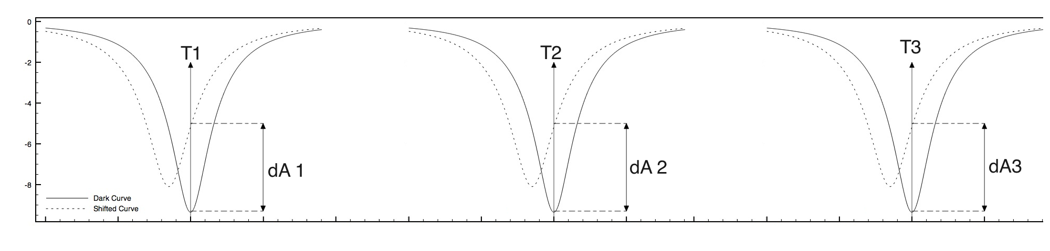
Natural multiplexing in KID devices
Each LEKID is a high Q micro-resonator with a tunable f0
We can therefore multiplex many LEKIDs onto a single CPW feed-line

Slide 28
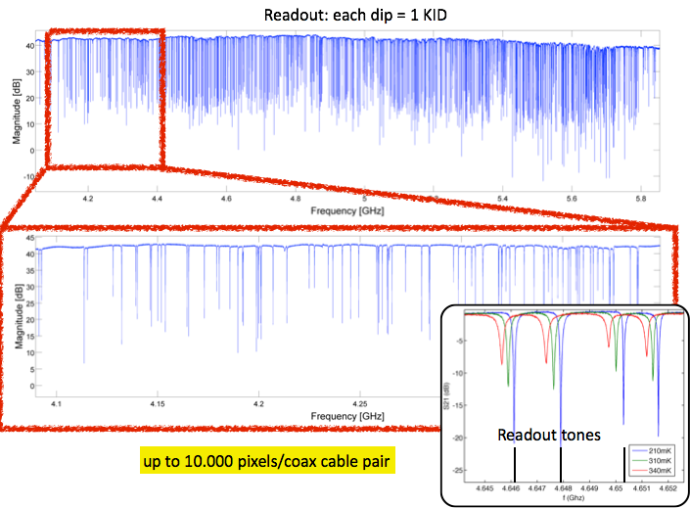
Principal of operation - Multiplexing

Slide 29
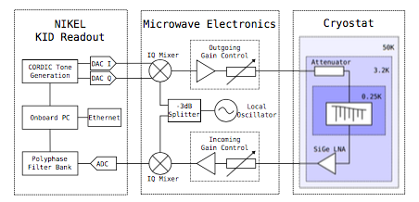
Simple Readout Electronics
Tone Generation
Mix up / Down
Probe KID
Light in through optics. E= hυ >2Δ
Warm
Cold

Slide 30
Making an array of LEKIDs
In most cases 1 deposition and etch step
Minimal material costs
Cleanroom time ½ day

Slide 31
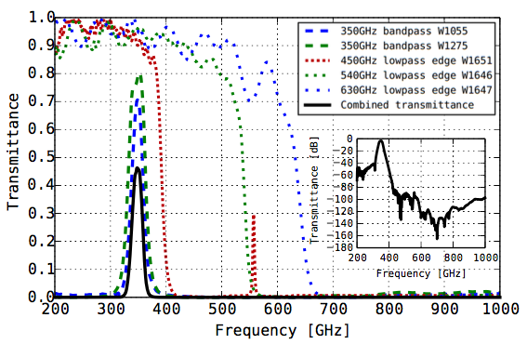
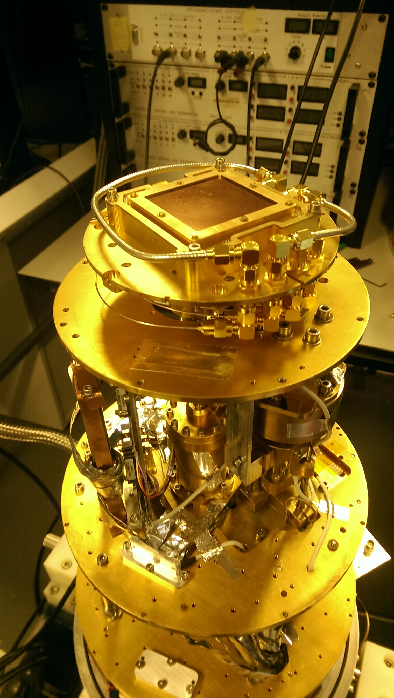
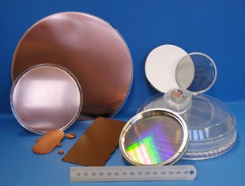
Optical coupling and band defining

Slide 32
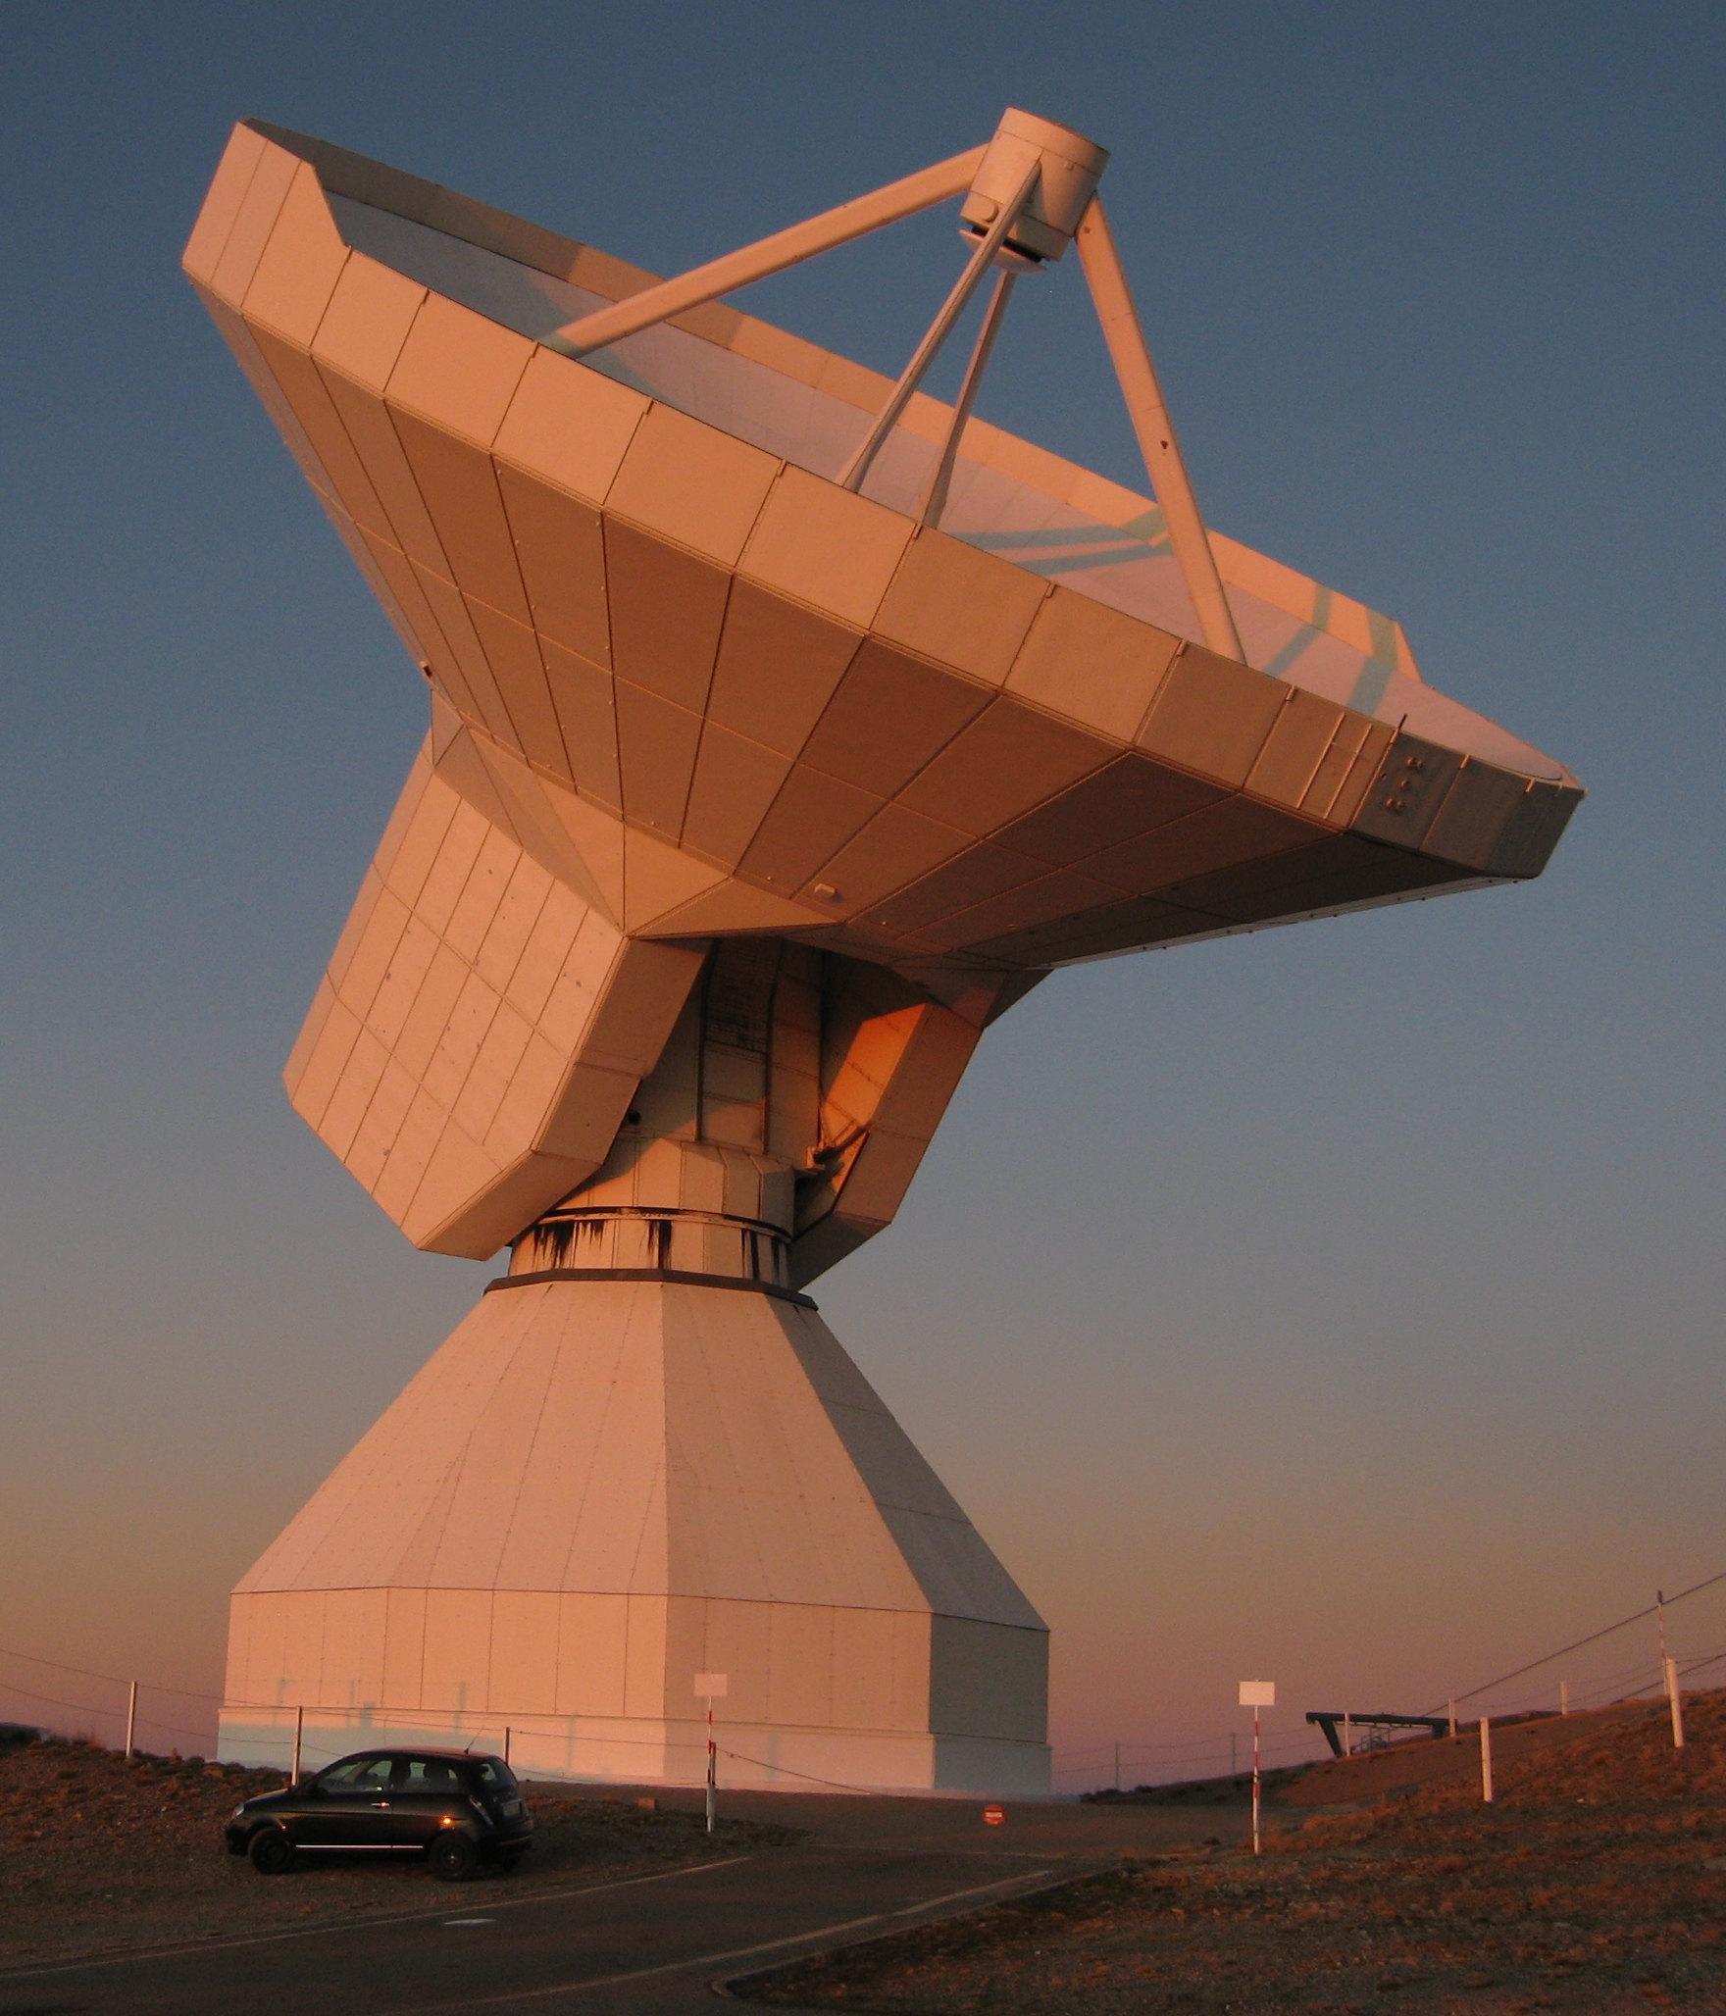
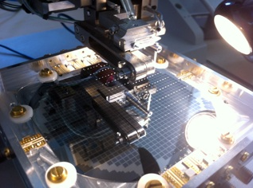
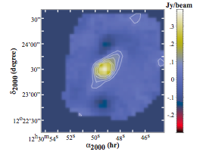
Current Instruments NIKA on IRAM
NIKA A dual band (150GHz and 220 GHz) mm astronomical camera on the IRAM telescope working just above the photon noise limit at 2mm
M87
1000 pixels @ 2mm
2 x 4000 pixels @ 1mm (2 arrays polarisation sensitive).

Slide 33
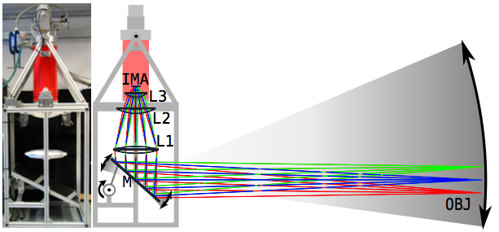
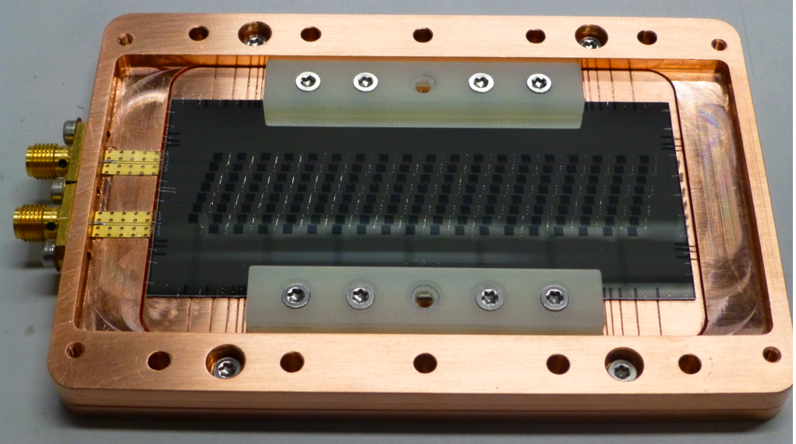
KIDcam – A Terrestrial THz imager

Slide 34
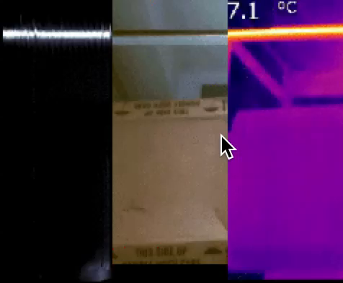
KIDcam – A Terrestrial THz imager

Slide 35
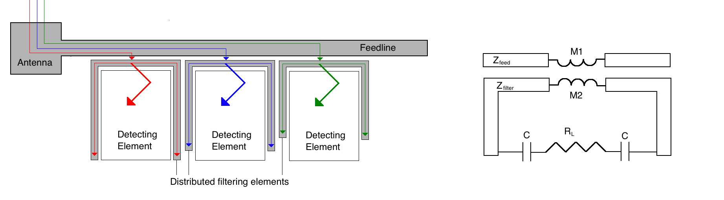
On-Chip Spectrometers
High TC material like Niobium
hν<2Δ ν_{cut} ≈ 600 GHz
Low TC material like Aluminium
Hν>2Δ ν_{cut} ≈ 90 GHz

Slide 36
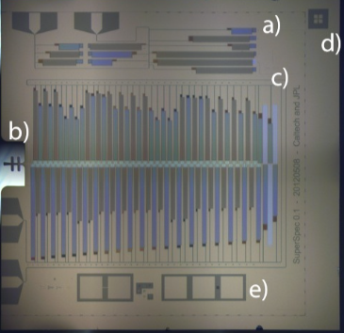




On-Chip Spectrometer Results

Slide 37




Current applications – Optical photon counting and energy resolving detection
Images courtesy of Ben Mazin, University of Santa Barbara, USA

Slide 38
Conclusion
LEKIDs have been demonstrated to work across a wide range of sensing applications. Some of the key benefits of LEKIDs are:
Relatively immune to temperature fluctuations
Very easy to fabricate (single layer process)
Inherently easy to multiplex – MUX ratios of up to 10’000 are achievable
Are sensitive – will meet the photon-noise limit in most cases
Can be used to energy resolve for single photon counting applications.
Are fast – time constants typically of order 10-50 microseconds

Slide 39
Two-Fluid model of a Superconductor
Below T_{c}, the electron population splits into two separate population
  One of normal electrons known as Quasi-Particles
  One of electrons paired together with a typical binding energy 2Δ of around 0.4 meV (Aluminium). These paired electrons are commonly known as Cooper pairs.
The quasi-particle population acts as a normal metal would do, i.e. is resistive. This gives us a conductance σ₁
The paired population are have no resistance but do have an associated reactance known as Kinetic Inductance / Internal Inductance. This gives us a conductance jσ₂
Absorption of a photon with hυ> 2Δ breaks Copper pairs and alters these populations.

Slide 40

Internal Inductance for practical film thicknesses
Quite often we are working between the limits of t << λ_{L} and t >> λ_{L}. In this case we need to perform the surface integrals for current over the entire ﬁlm cross-sectional area and take into account any variations in current density.

Slide 41

The London penetration depth
For a non-scattering electron volume
For a superconducting electron volume
Applying Maxwell’s equations to a perfect conductor displays diamagnitism of AC magnetic fields.
London and London suggested a set of constitutive conditions to Maxwell’s equations so that both DC and AC fields as expelled from the bulk of a superconductor.
The field decays to 1/e of its value at the surface within the London penetration depth λ_{L}.
The London Penetration depth

Slide 42


Is a commercial sub-K system viable?
Modern pulse tube systems now cryogen free and push button operation.
Closed cycle systems can be automated and continuous. No user input necessary.

